Slide 1
Nagulapati Pranavi
Final Project
3/21/2024 Annual Review

Slide 2
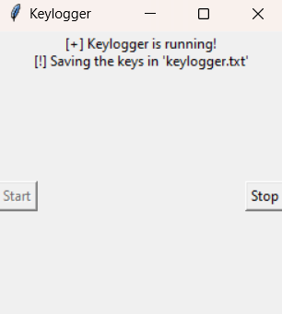
PROJECT TITLE
KEYLOGGER AND SECURITY
3/21/2024 Annual Review

Slide 3


AGENDA
Understanding the problem statement
Project Overview
End-users of the project
Our solution and its value proposition
Finding the wow element in our solution
Discussion of modelling our project
The final results of our project
3/21/2024 Annual Review

Slide 4

PROBLEM STATEMENT
Develop Keylogger malicious software, invisibly record keystrokes, stealing passwords, credit card numbers, and any typed data. This exposes users and their sensitive information, demanding improved methods to detect and eliminate these hidden threats.
3/21/2024 Annual Review

Slide 5

PROJECT OVERVIEW
Brief Description of the Project's Scope and Objectives
Overview of Keylogger Detection and Prevention Strategies
Importance of Developing Effective Solutions in the Cybersecurity Landscape
3/21/2024 Annual Review

Slide 6

WHO ARE THE END USERS?
Parents (monitoring online activity with consent)
Businesses (tracking employee efficiency with clear policies)
Security professionals (education, detection methods, authorized testing)
3/21/2024 Annual Review

Slide 7

YOUR SOLUTION AND ITS VALUE PROPOSITION
Parental Control: Monitoring children's online activity to ensure safety (requires open communication and clear boundaries).
Employee Monitoring: In some workplaces, monitoring may be necessary to safeguard sensitive information or enforce company policies (strict transparency and regulations are essential).
Accessibility Tools: For users with physical limitations, keyloggers can be part of assistive technologies.
3/21/2024 Annual Review

Slide 8


THE WOW IN YOUR SOLUTION
It saves the text wherever the text is given on the PC
It is a basic hacking technique
Focus on empowering users! Imagine interactive tutorials that teach online safety, or real-time monitoring that alerts users to suspicious activity, giving them control.
3/21/2024 Annual Review
8

Slide 9
MODELLING
Teams cam add wireframes
Threat Modeling:
Identify potential security threats the software aims to address (phishing, unauthorized access).
User Activity Modeling:
Create user profiles and baseline activity patterns (login times, typical actions).
Data Flow Modeling:
Map the flow of captured data (keystrokes, timestamps).
Design secure storage mechanisms (encryption) and access controls.
3/21/2024 Annual Review
9

Slide 10
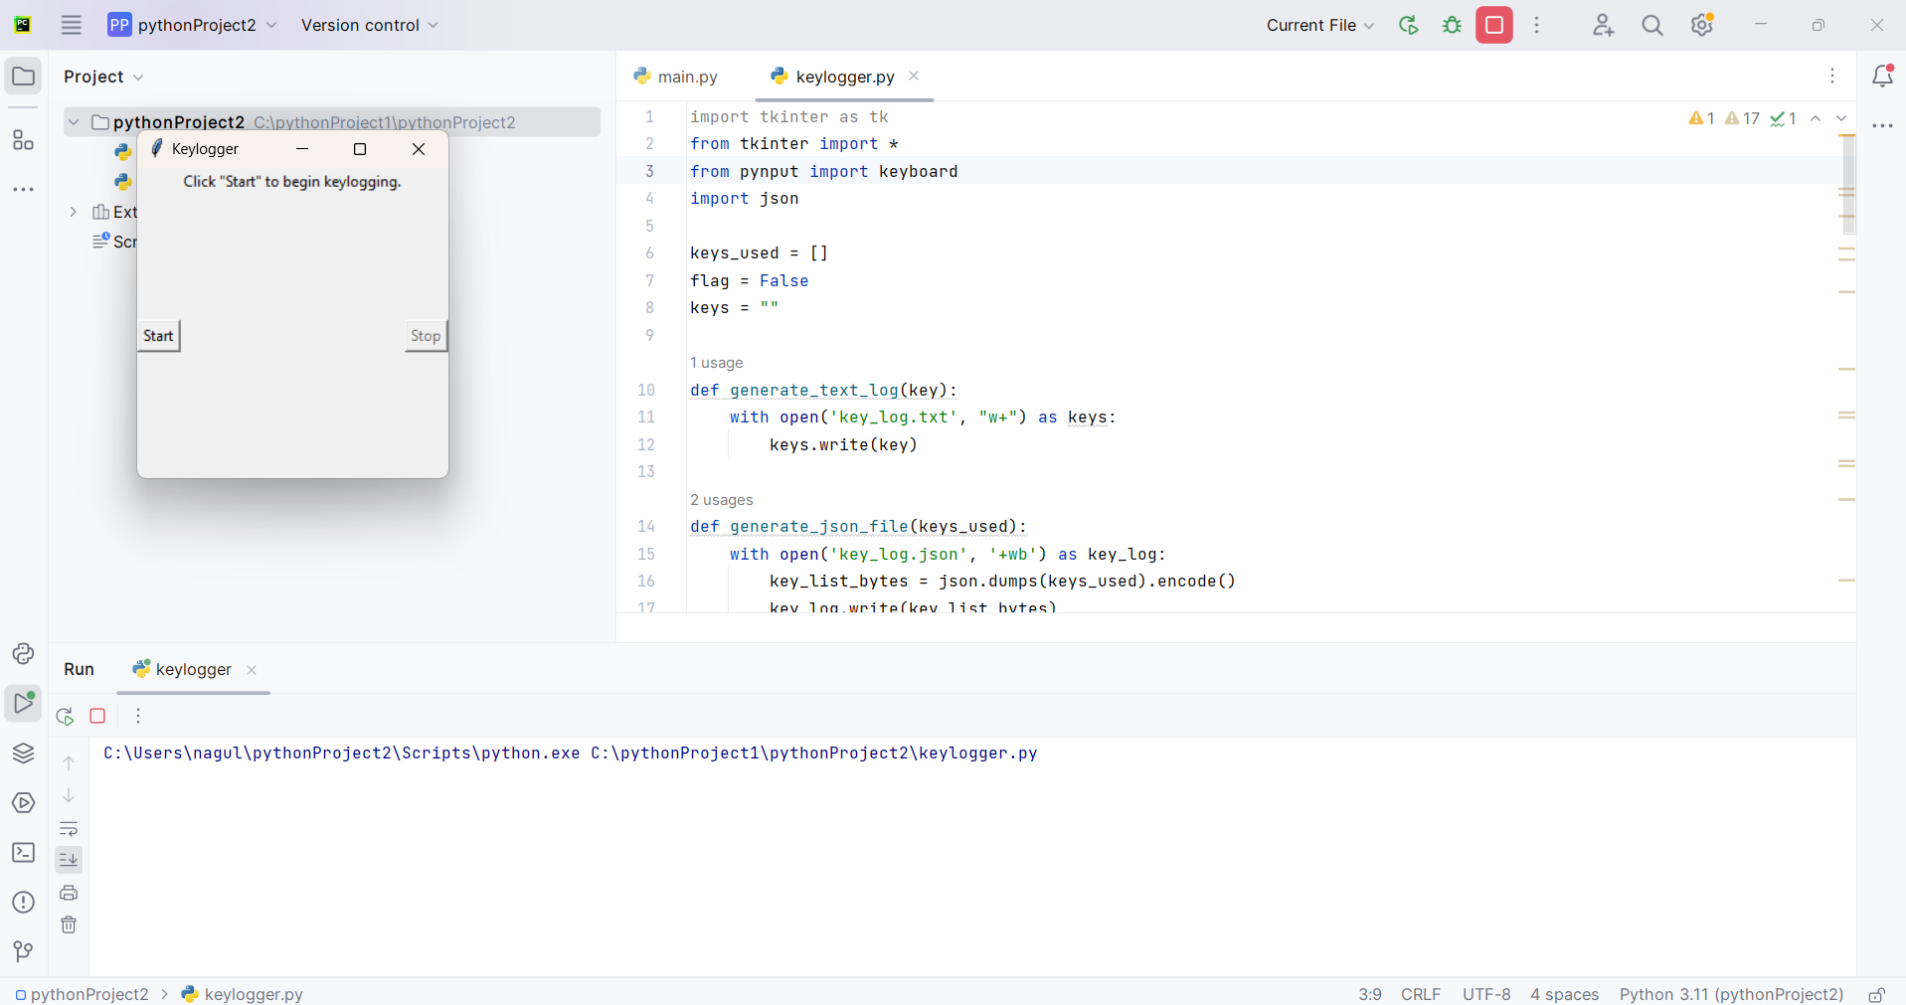
RESULTS
3/21/2024 Annual Review
10

